Slide 1

Sales Prediction Model
Johnroe Paulo Cañamaque
Data Science Student
November 1, 2023

Slide 2
Agenda
01. Data Presentation
02. Data Analysis
Data specifics and definition
Methodology
Data Insights
03. Model Design
Model Training and Evaluation
Best Model
November 1, 2023

Slide 3
Data Presentation
Column Name | Description
Item_Identifier | Unique product ID
Item_Weight | Weight of product
Item_Fat_Content | Whether the product is low fat or regular
Item_Visibility | The percentage of total display area of all products in a store allocated to the particular product
Item_Type | The category to which the product belongs
Item_MRP | Maximum Retail Price (list price) of the product
Outlet_Identifier | Unique store ID
Outlet_Establishment_Year | The year in which store was established
Outlet_Size | The size of the store in terms of ground area covered
Outlet_Location_Type | The type of area in which the store is located
Outlet_Type | Whether the outlet is a grocery store or some sort of supermarket
Item_Outlet_Sales | Sales of the product in the particular store. This is the target variable to be predicted.
Data Description
Data Definition
The data used in this study came from all food items sold at various stores from 1985 to 2009
Data used has 8,523 rows and 12 columns
Accessible through here

Slide 4
Data Analysis
Preparation
Data Collection
Exploration
Univariate and Multivariate Analysis
Correlation
Explanation
Insights Discovery
Data Clean-up
Distribution
Model Generation
Fitting
Evaluation
Testing
Pre-processing
Methodology
November 2, 2023

Slide 5
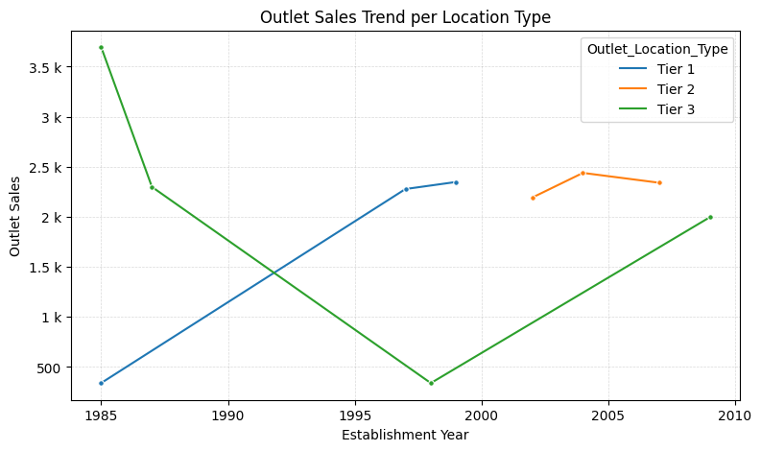
Data Analysis
Insights Discovered
Tier 1 had an uptrend that spans from 1985 up to 2000.
Tier 2 has an uptrend that spans from around 2002 up to 2007. It also suggests that Tier 2 outlets only started around that time
Tier 3 had a downtrend from 1985 to 1997, but had an uptrend from 1997 until 2010
The data does not suggest continuous trend for each tier. Further data processing needed or more data should be used in order to find the patterns and trends needed.
November 2, 2023

Slide 6
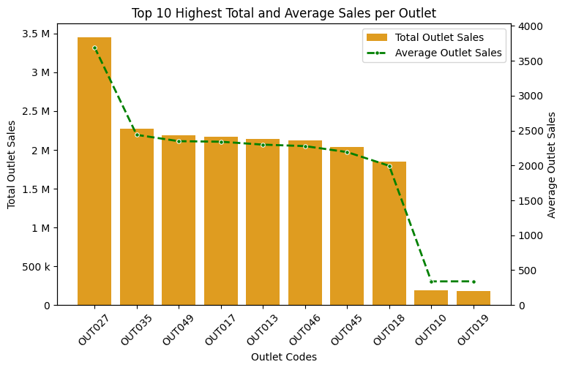
Data Analysis
Insights Discovered
OUT027 has the highest sales all time with around 3.45 million sales, averaging 3694.04 of sales all time
OUT019 has the lowest sales all time with around 179,694 sales, averaging 340.33 of sales all time
November 2, 2023

Slide 7
Model Design
Comparison of implemented models
 | Linear Regression | Decision Trees Regression*
RMSE @ Train | 1,208 | 1,082
RMSE @ Test | 1,165 | 1,057
Confidence Score @ Train | 51% | 60%
Confidence Score @ Test | 51% | 59%
* tuned by max_depth only

Slide 8

Thank you

